Slide 1
JAVA Lecture 11
Inheritance and “super” keyword

Slide 2





Slide 3
INHERITANCE

Slide 4
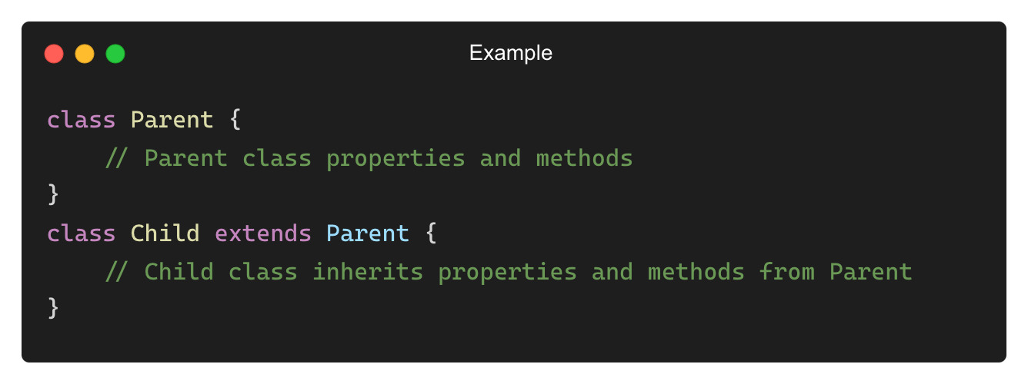
What is Inheritance?
A mechanism in Java where one class (child) derives properties and behavior from another class (parent).
It helps in code reusability and hierarchy management.

Slide 5
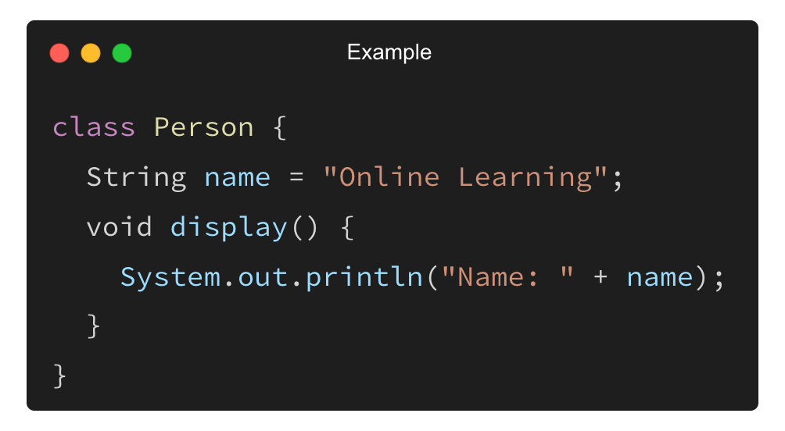
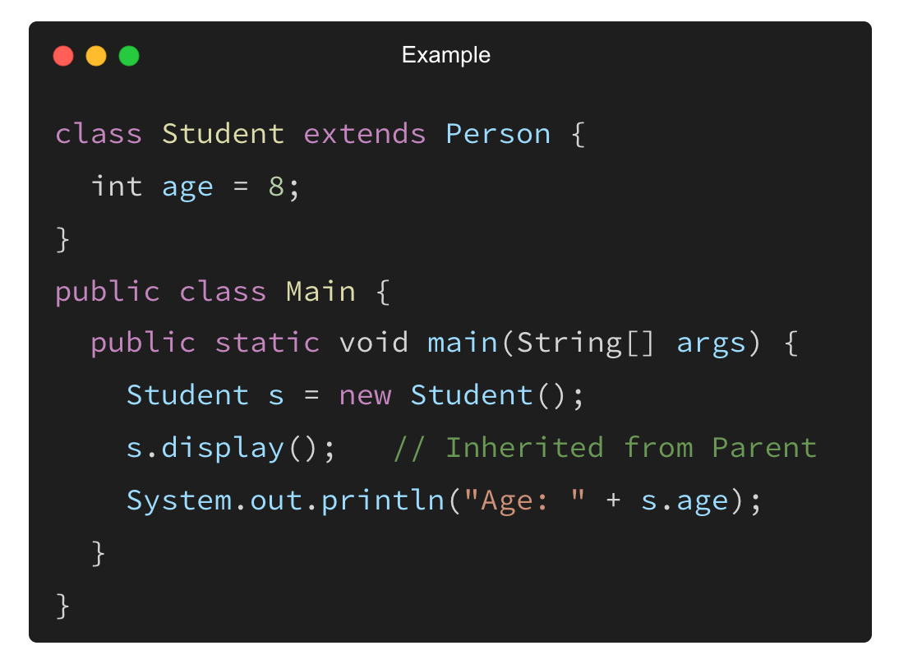
Example of Single Inheritance
Superclass (Parent Class):
Subclass (Child Class):
Output: Name: Online Learning
Age: 8

Slide 6
Types of Inheritance in Java
Type | Description | Example
Single Inheritance | One class inherits from another. | class A → class B
Multi-level Inheritance | A class inherits from another class, forming a chain. | class A → class B → class C
Hierarchical Inheritance | One parent class has multiple child classes. | class A → class B, class C
Multiple Inheritance (via Interfaces) | Java does not support multiple inheritance with. classes, but it does with interfaces. | interface A, interface B → class C

Slide 7
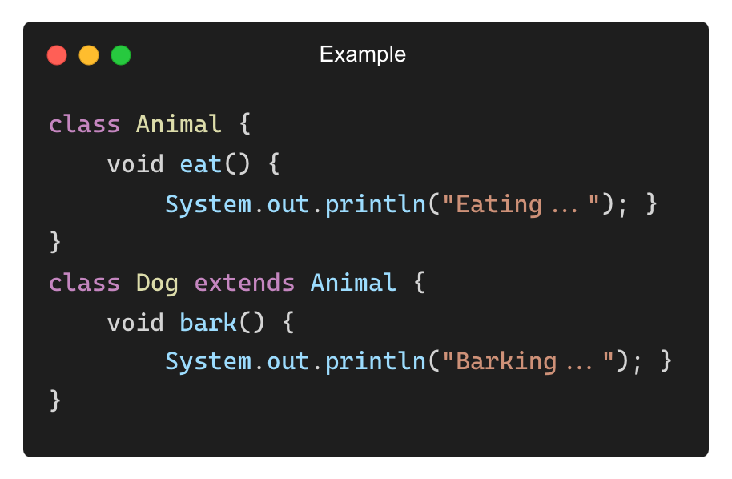
Why Use Inheritance?
Code Reusability: Eliminates redundant code.
Enhances Readability: Organizes code in a structured way.
Supports Extensibility: Allows easy addition of new features.
Establishes Relationships: “is-a” relationship (e.g., Student is a Person).
Output:
Eating...
Barking...

Slide 8
Access Modifiers and Inheritance
Modifier | Accessible in Subclass? | Accessible Outside Package?
public | ✅ Yes | ✅ Yes
protected | ✅ Yes | ❌ No (Unless accessed through inheritance)
default (no modifier) | ✅ Yes (Same package) | ❌ No
private | ❌ No | ❌ No

Slide 9
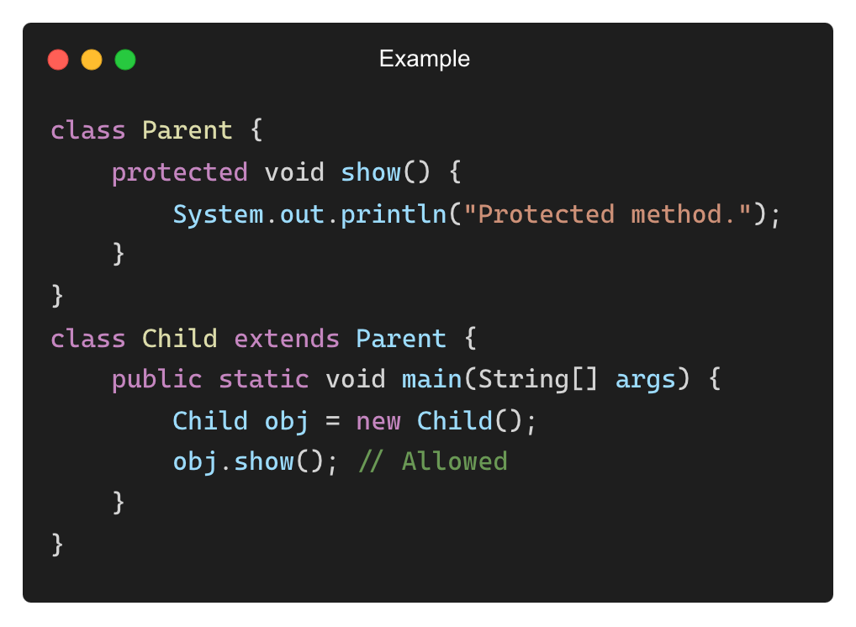
Access Modifiers and Inheritance (Example)
Output:
Protected method.

Slide 10
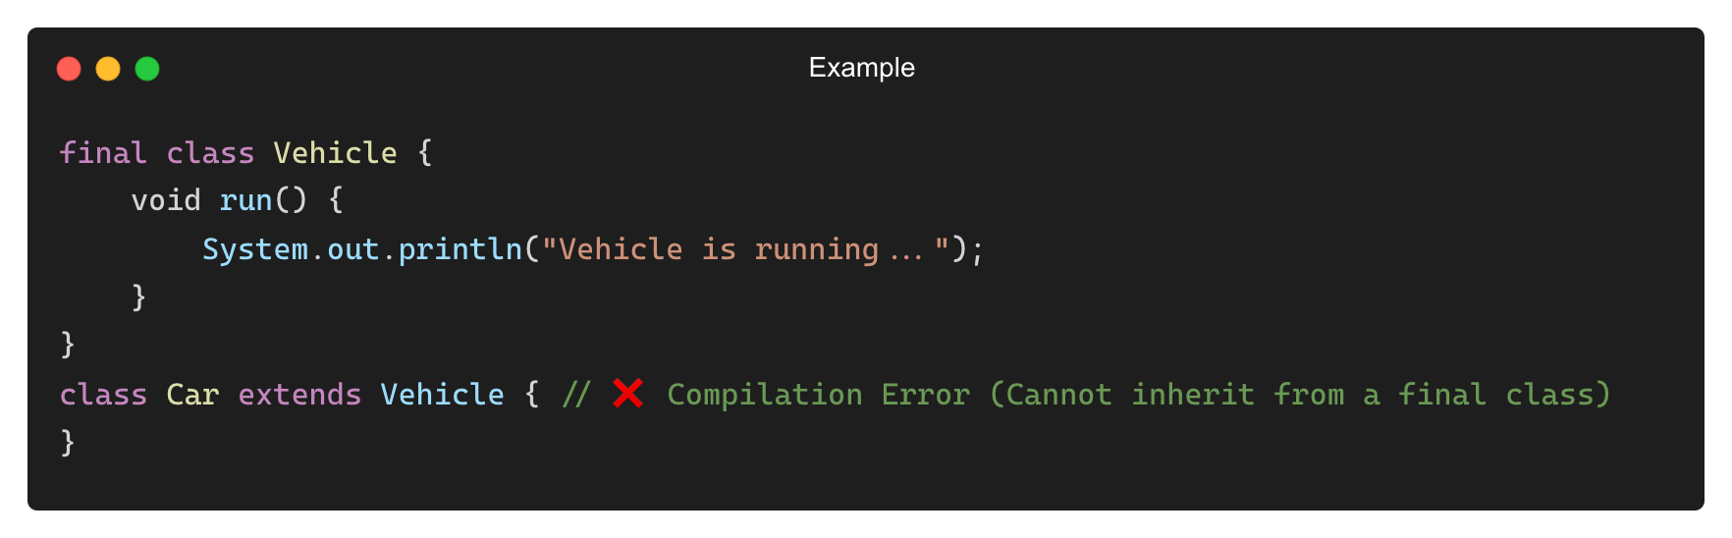
Preventing Inheritance with final Keyword
final Keyword prevents a class from being inherited.
• When to use final in classes?
✅ When you want to prevent modification of the class.
✅ When you create utility/helper classes.

Slide 11
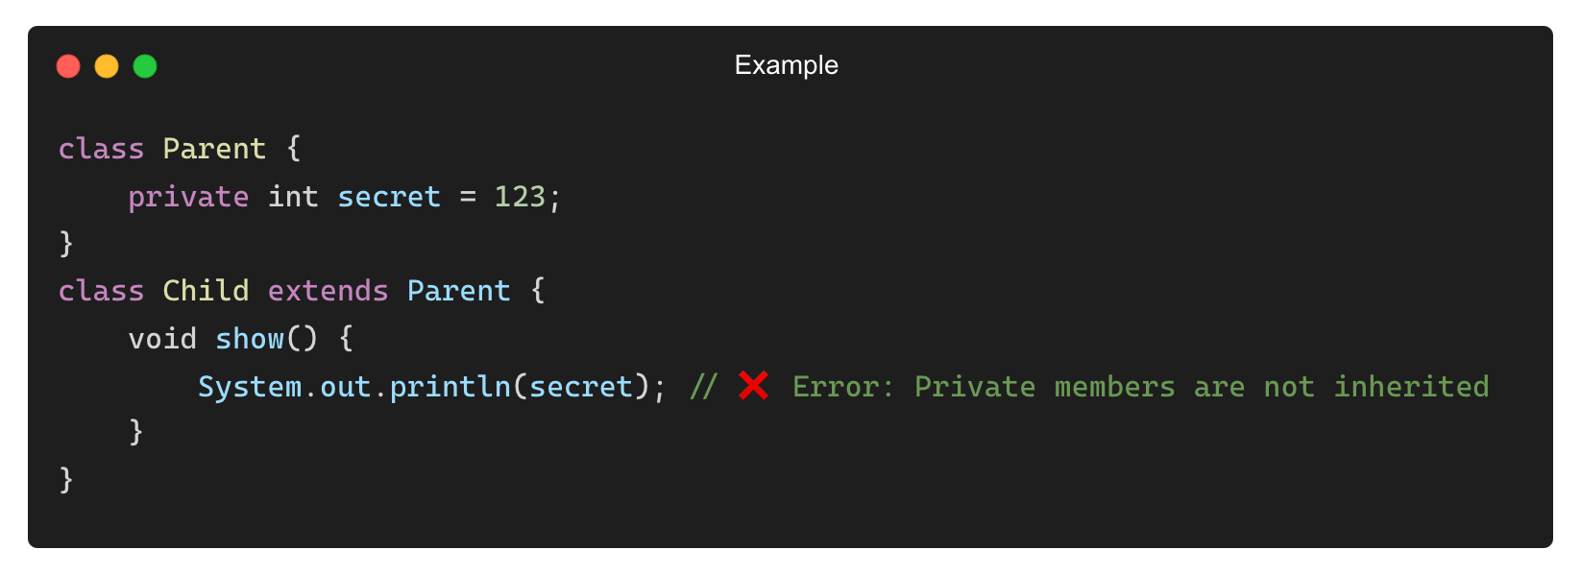
Common Mistakes in Inheritance
❌ Trying to Access Private Members from Parent Class
✅ Solution: Use protected or public members in the parent class.

Slide 12
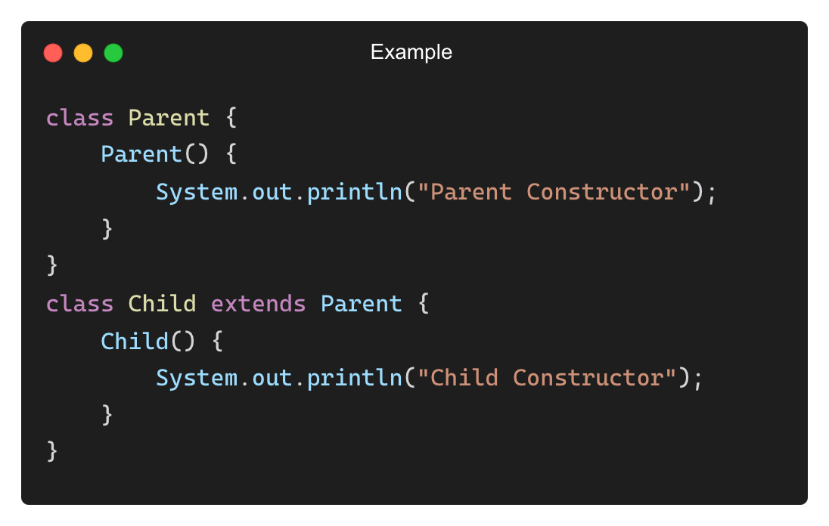
Common Mistakes in Inheritance (Contd.)
❌ Forgetting super to Call Parent Class Constructor
✅ Solution: Call super() explicitly in the subclass constructor.

Slide 13
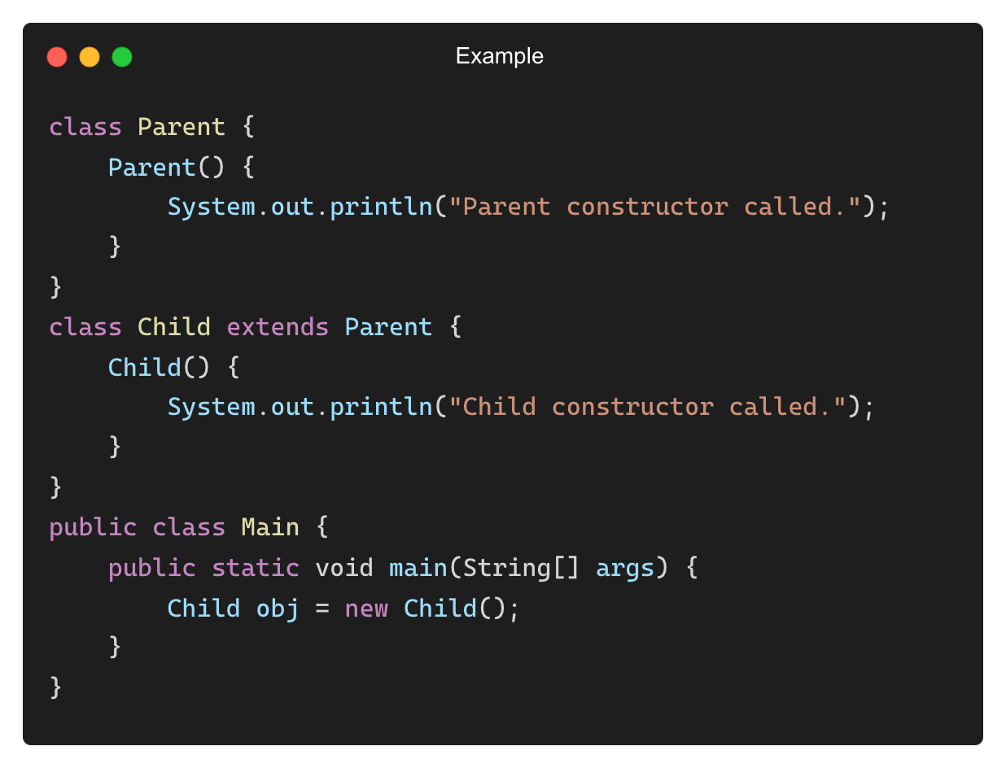
Do Constructors Get Inherited?
No, constructors are not inherited, but the subclass automatically calls the parent class constructor.
Output: Parent constructor called.
Child constructor called.

Slide 14
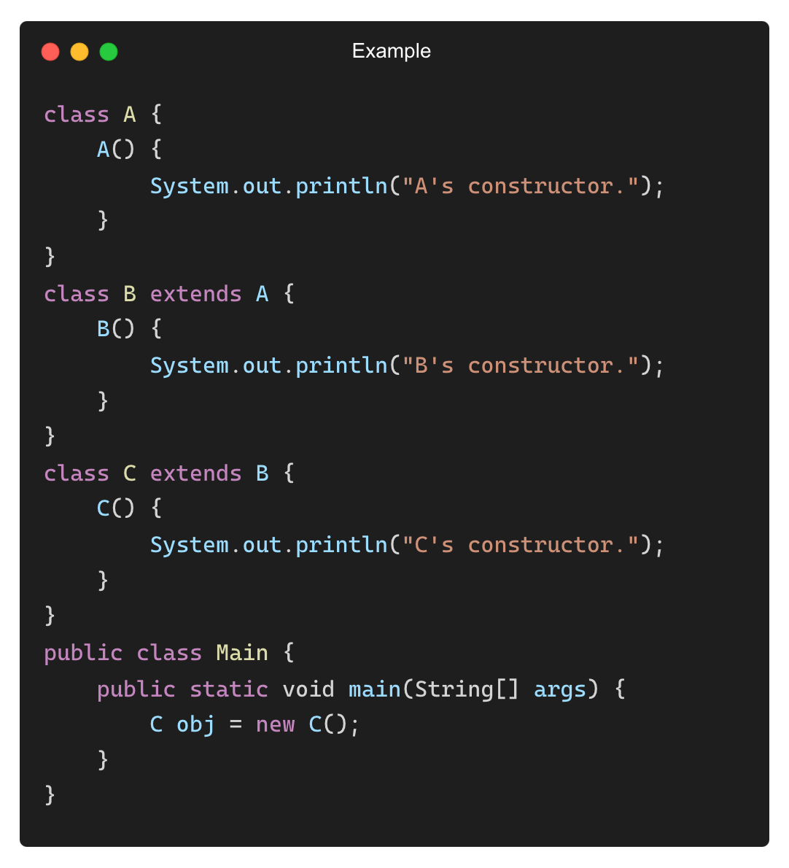
Understanding Constructor Execution Order
When a subclass object is created, the parent class constructor runs first.
Why?
The child class depends on the parent class, so it must initialize the parent class first.
Output: A's constructor.
B's constructor.
C's constructor.

Slide 15
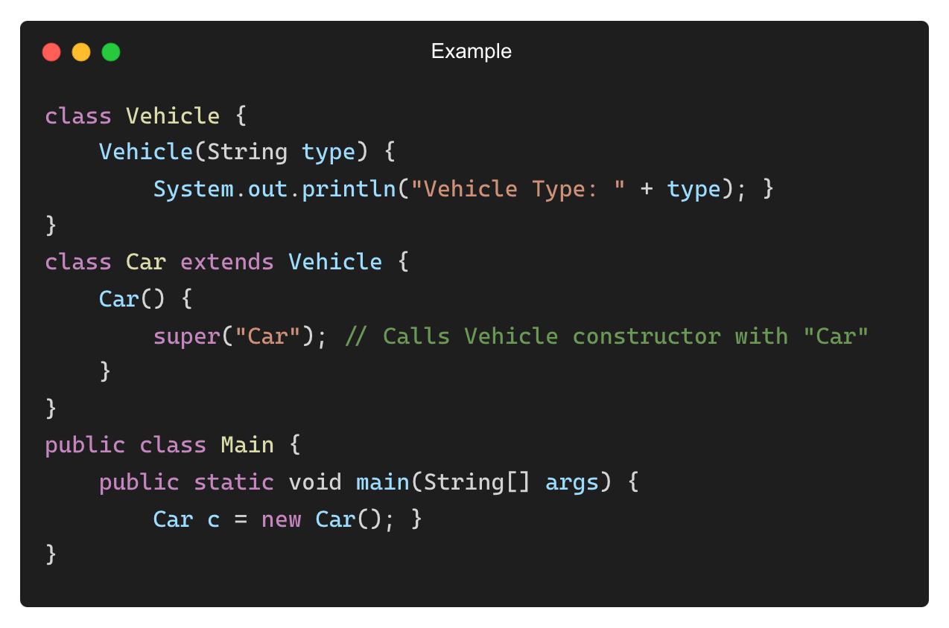
Calling a Parameterized Parent Constructor
If the parent class has only a parameterized constructor, the child class must call it using super().
Output: Vehicle Type: Car

Slide 16
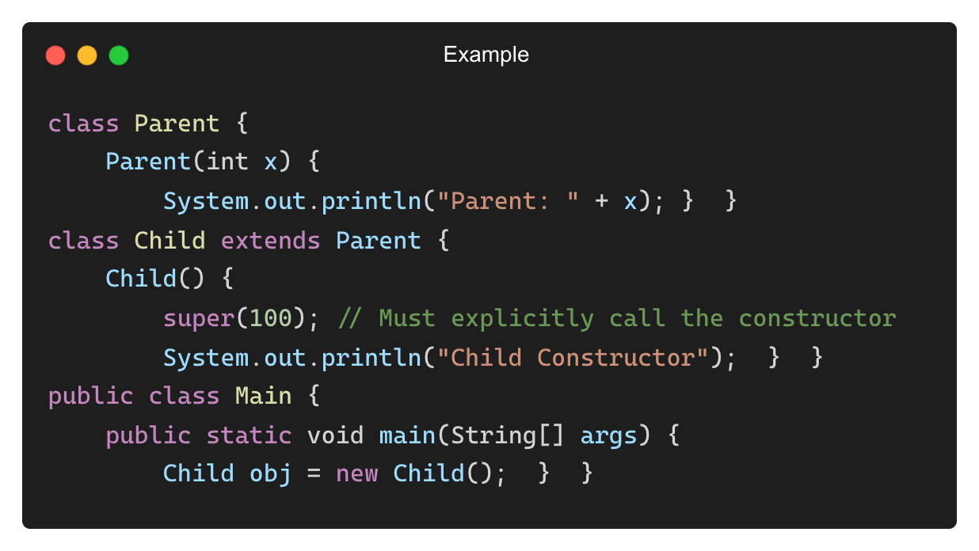
Default Constructor vs. Parameterized Constructor
Scenario | Parent Constructor | Child Constructor
Default constructor | Automatically called | Automatically called
Parameterized constructor | Needs super() to be called | Can also have parameters
Output:
Parent: 100
Child Constructor

Slide 17
“SUPER”

Slide 18
What is super in Java?
The super keyword is used to refer to the immediate parent class.
Use Cases:
Access superclass methods when overridden in a subclass
Call superclass constructors using super()
Access superclass fields when hidden by subclass variables

Slide 19
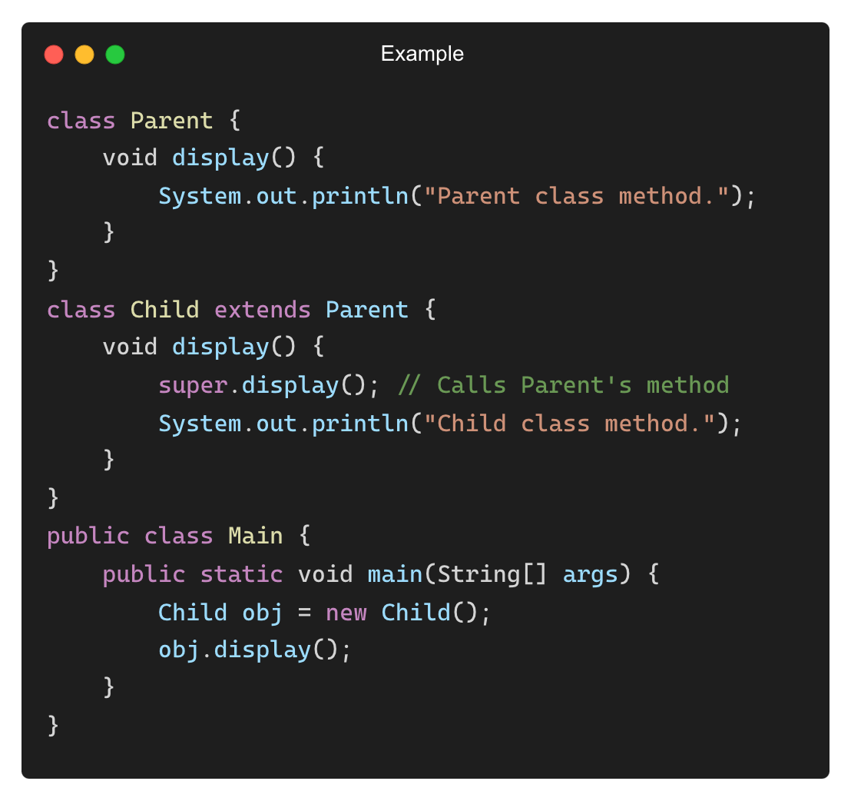
Using super to Call Parent Class Methods
Output: Parent class method.
Child class method.

Slide 20
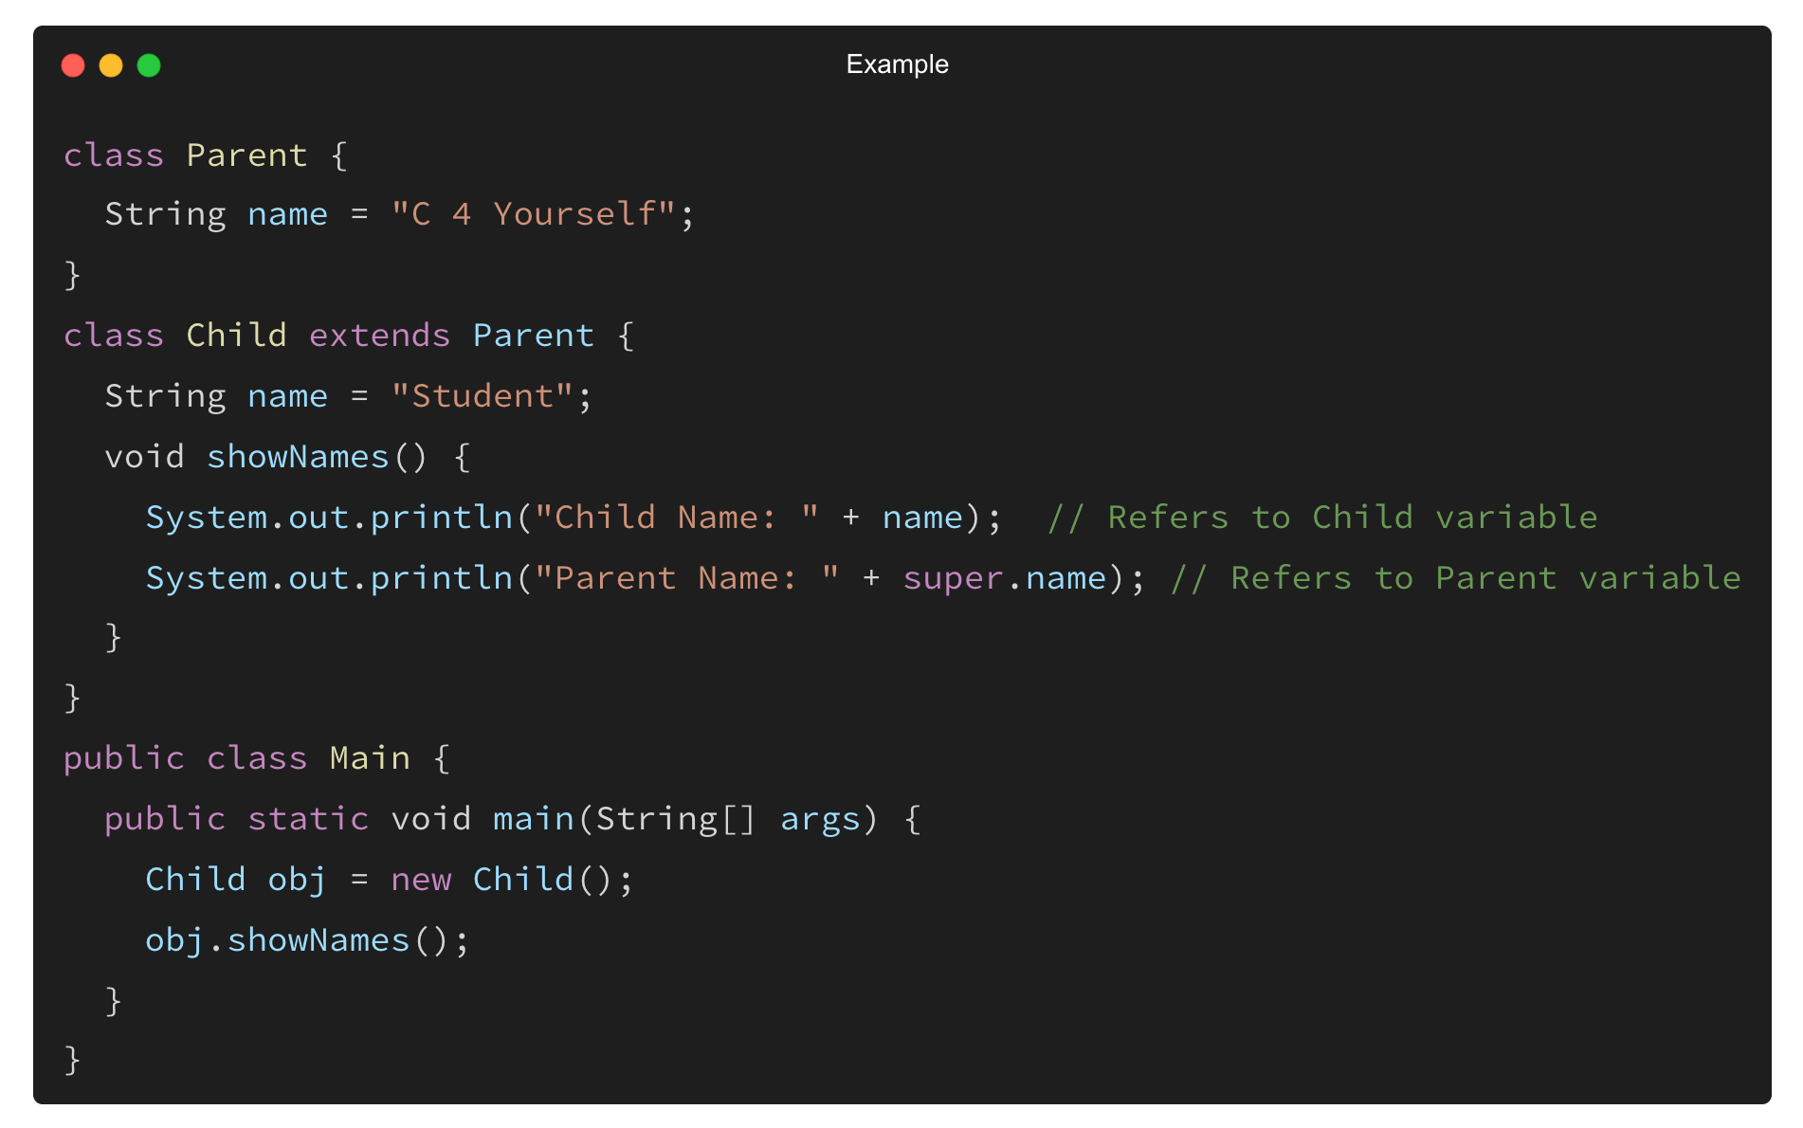
Using super to Access Parent Class Variables
Output:
Child Name: Student
Parent Name: C 4 Yourself

Slide 21
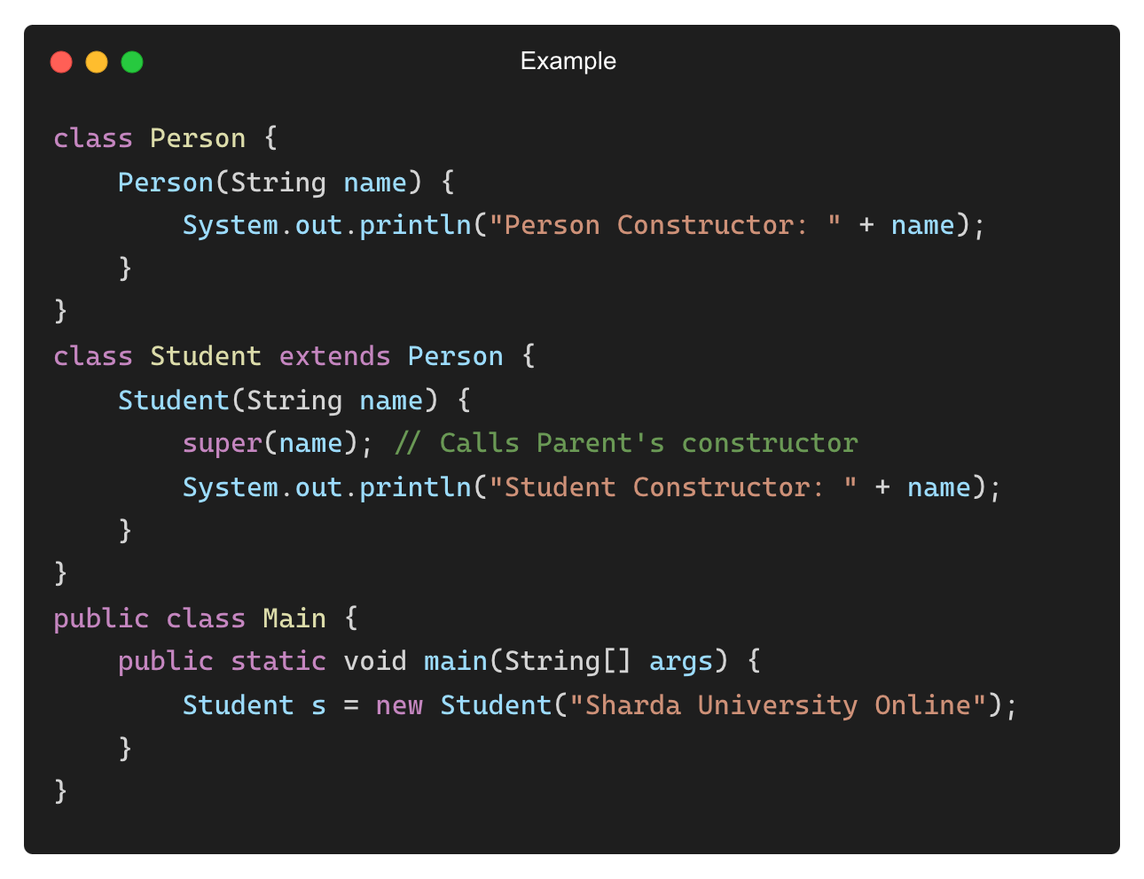
Calling a Parent Class Constructor Using super()
Output:
Person Constructor: Sharda University Online
Student Constructor: Sharda University Online

Slide 22
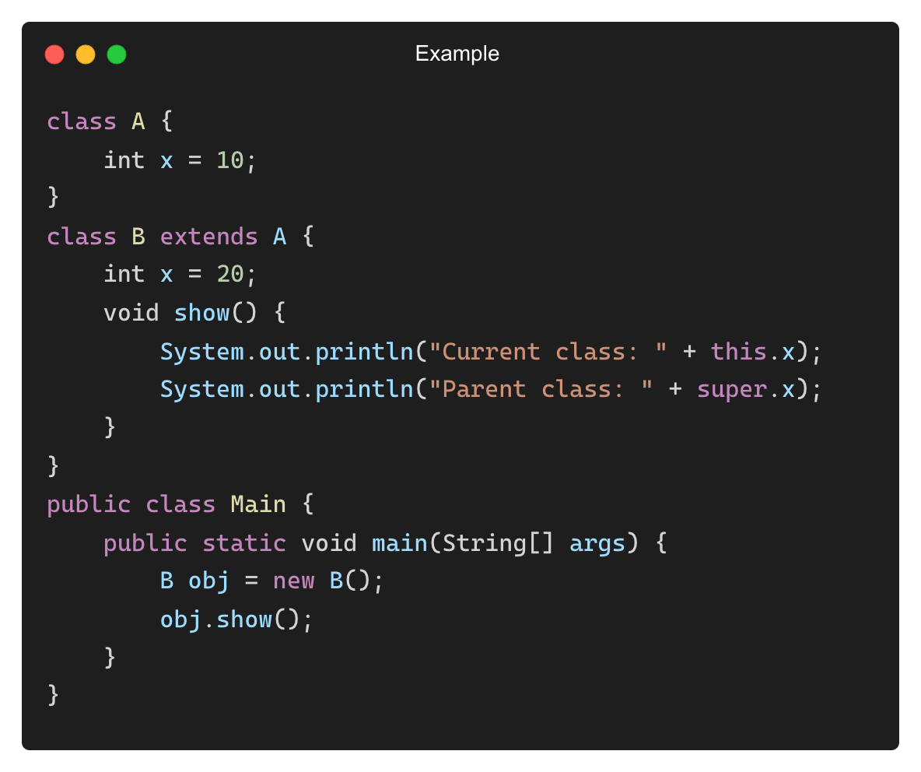
Difference Between super and this
Feature | super | this
Refers To | Parent class | Current class
Calls Constructor | super() (Parent Constructor) | this() (Current Constructor)
Calls Method | Calls parent class method | Calls current class method
Variable Access | Parent class variable | Current class variable
Output:
Current class: 20
Parent class: 10

Slide 23
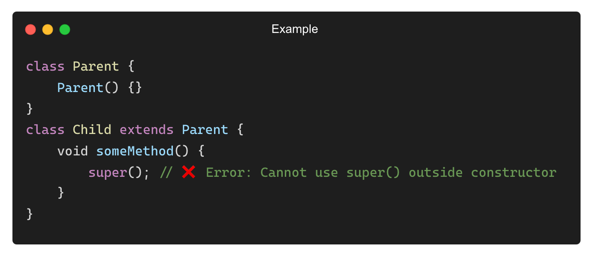
Common Mistakes with super Keyword
❌ Trying to Use super() in a Non-Constructor Method
✅ Solution: Use super() inside a constructor.

Slide 24
THANK YOU

